Slide 1
Context-Free Grammars (CFGs)
Chapter-5 (Last Part)

Slide 2
Contents
Definitions
Relationship to Left- and Rightmost Derivations
Ambiguity in Grammars
Eliminate ambiguity

Slide 3
Parse Trees
Parse trees are trees labeled by symbols of a particular CFG.
Leaves: labeled by a terminal or ε.
Interior nodes: labeled by a variable.
  Children are labeled by the right side of a production for the parent.
Root: must be labeled by the start symbol.

Slide 4
Example: Parse Tree
S -> SS | (S) | ()
S
S
S
(
S
)
(
)
(
)

Slide 5
Yield of a Parse Tree
The concatenation of the labels of the leaves in left-to-right order
  That is, in the order of a preorder traversal.
is called the yield of the parse tree.
Example: yield of is (())()
S
S
S
(
S
)
(
)
(
)

Slide 6
Parse Trees, Left- and Rightmost Derivations
For every parse tree, there is a unique leftmost, and a unique rightmost derivation.
We’ll prove:
  If there is a parse tree with root labeled A and yield w, then A =>*_{lm} w.
  If A =>*_{lm} w, then there is a parse tree with root A and yield w.

Slide 7
Proof – Part 1
Induction on the height (length of the longest path from the root) of the tree.
Basis: height 1. Tree looks like
A -> a₁…a_{n} must be a production.
Thus, A =>*_{lm} a₁…a_{n}.
A
a₁
. . .
a_{n}

Slide 8
Part 1 – Induction
Assume (1) for trees of height < h, and let this tree have height h:
By IH, X_{i} =>*_{lm} w_{i}.
  Note: if X_{i} is a terminal, then X_{i} = w_{i}.
Thus, A =>_{lm} X₁…X_{n} =>*_{lm} w₁X₂…X_{n} =>*_{lm} w₁w₂X₃…X_{n} =>*_{lm} … =>*_{lm} w₁…w_{n}.
A
X₁
. . .
X_{n}
w₁
w_{n}

Slide 9
Proof: Part 2
Given a leftmost derivation of a terminal string, we need to prove the existence of a parse tree.
The proof is an induction on the length of the derivation.

Slide 10
Part 2 – Basis
If A =>*_{lm} a₁…a_{n} by a one-step derivation, then there must be a parse tree
A
a₁
. . .
a_{n}

Slide 11
Part 2 – Induction
Assume (2) for derivations of fewer than k > 1 steps, and let A =>*_{lm} w be a k-step derivation.
First step is A =>_{lm} X₁…X_{n}.
Key point: w can be divided so the first portion is derived from X₁, the next is derived from X₂, and so on.
  If X_{i} is a terminal, then w_{i} = X_{i}.

Slide 12
Induction – (2)
That is, X_{i} =>*_{lm} w_{i} for all i such that X_{i} is a variable.
  And the derivation takes fewer than k steps.
By the IH, if X_{i} is a variable, then there is a parse tree with root X_{i} and yield w_{i}.
Thus, there is a parse tree
A
X₁
. . .
X_{n}
w₁
w_{n}

Slide 13
Parse Trees and Rightmost Derivations
The ideas are essentially the mirror image of the proof for leftmost derivations.
Left to the imagination.

Slide 14
Parse Trees and Any Derivation
The proof that you can obtain a parse tree from a leftmost derivation doesn’t really depend on “leftmost.”
First step still has to be A => X₁…X_{n}.
And w still can be divided so the first portion is derived from X₁, the next is derived from X₂, and so on.

Slide 15
Ambiguous Grammars
A CFG is ambiguous if there is a string in the language that is the yield of two or more parse trees.
Example: S -> SS | (S) | ()
Two parse trees for ()()() on next slide.

Slide 16
Example – Continued
S
S
S
S
S
S
S
S
(
)
(
)
S
S
(
)
(
)
(
)
(
)

Slide 17
Ambiguity, Left- and Rightmost Derivations
If there are two different parse trees, they must produce two different leftmost derivations by the construction given in the proof.
Conversely, two different leftmost derivations produce different parse trees by the other part of the proof.
Likewise for rightmost derivations.

Slide 18
Ambiguity, etc. – (2)
Thus, equivalent definitions of “ambiguous grammar’’ are:
  There is a string in the language that has two different leftmost derivations.
  There is a string in the language that has two different rightmost derivations.

Slide 19
Ambiguty (contd…)
Troubles program compilation
Eliminates ambiguity by transforming the grammar into unambiguous.
Drawbacks:
  Parsing complexity
  Affects other phases

Slide 20
Ambiguous grammar (Example)
E -> E+E|E*E|id
Draw parse tree for the string id+id*id

Slide 21
Reasons
Three main reasons lead to ambuity:
  Precedence
  Associativity
  Dangling else -> will be covered in Compiler course

Slide 22
Eliminating ambiguity
Rewriting the grammar (unambiguous grammar) or
Use ambiguous grammar with additional rules to resolve ambiguity

Slide 23
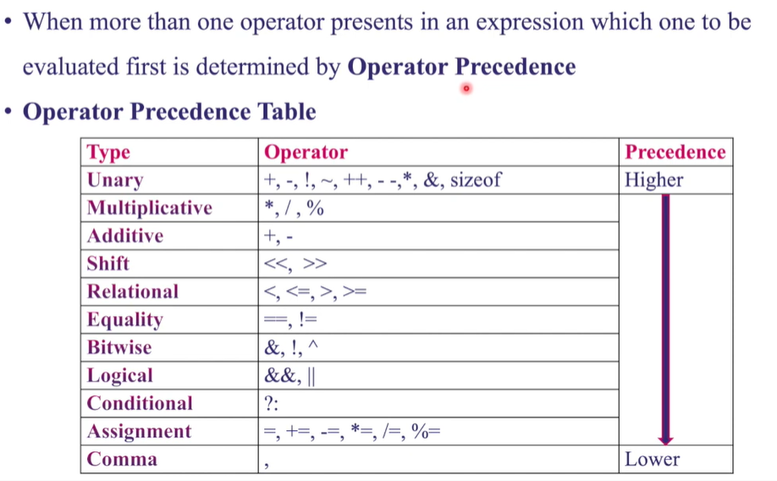
Eliminating Ambiguity with Operator Precedence

Slide 24
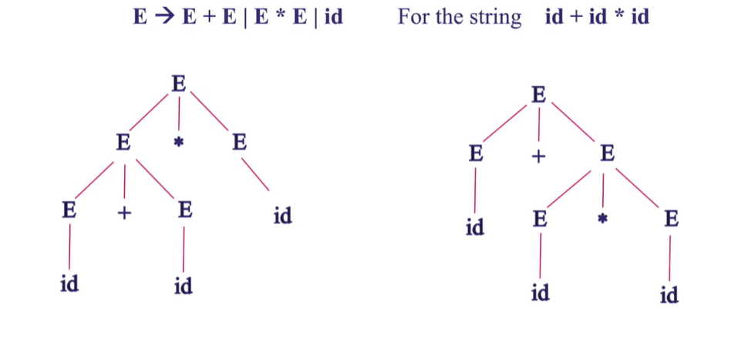
Operator Precedence-Grammar Example

Slide 25
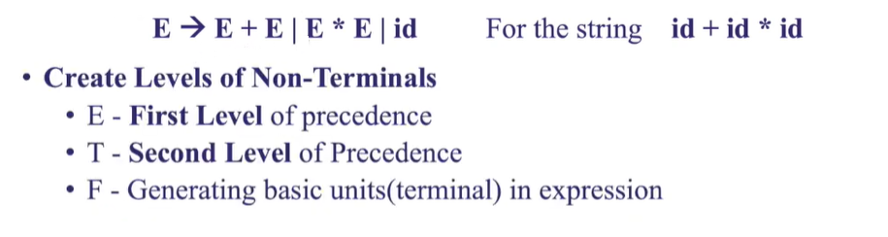
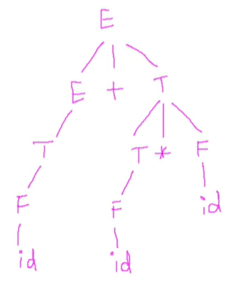
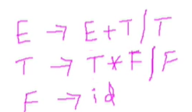
Rewrite Grammar with Additional Rules

Slide 26
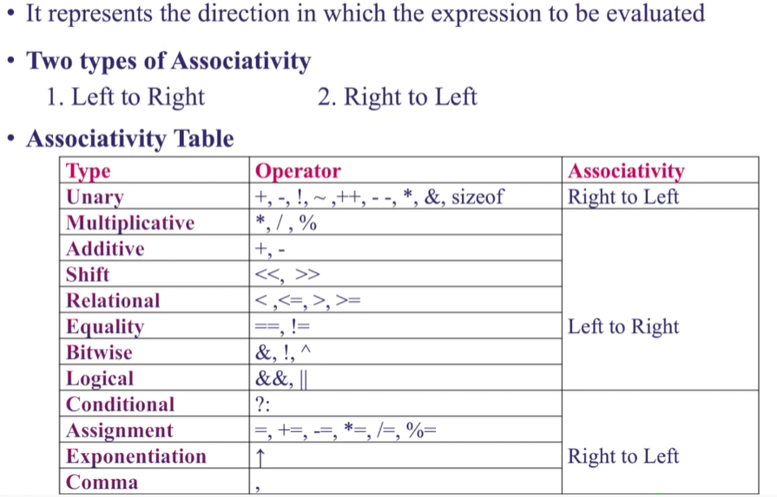
Eliminating Ambiguity with Associativity

Slide 27
Associativity-Examples
Example 1: a+b+c
Example 2: a=b=c

Slide 28
Types of Associativity
Left Associative Grammar
Right Associative Grammar

Slide 29
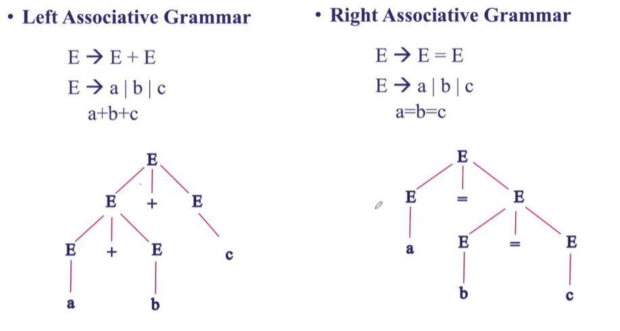
Associative Grammar

Slide 30
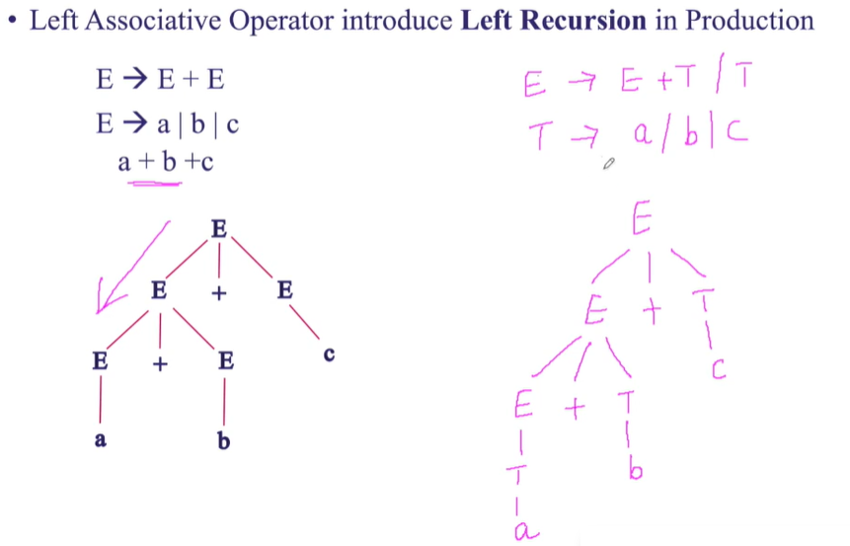
Left Associative- Rewrite the Grammar

Slide 31
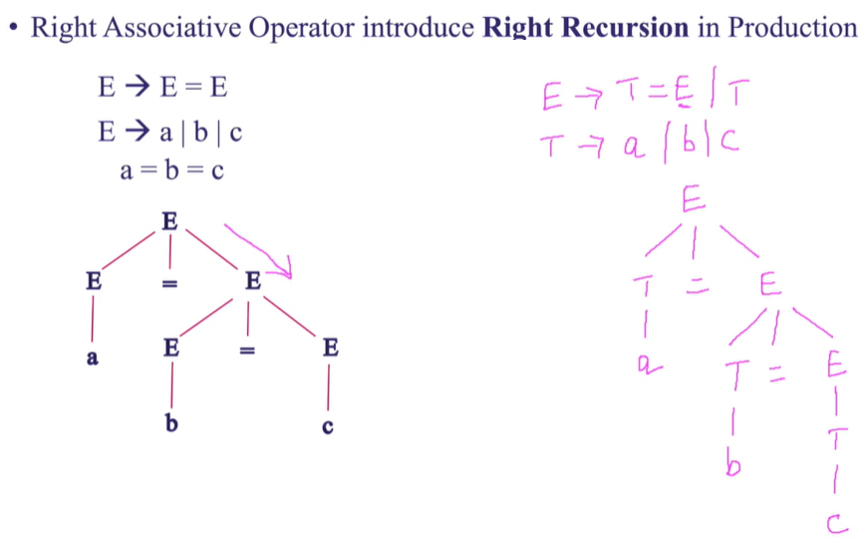
Right Associate- Rewrite the Grammar

Slide 32
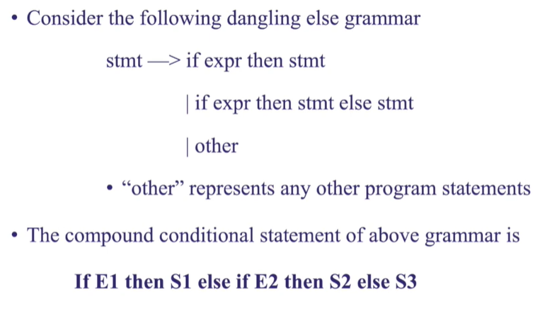
Dangling ELSE

Slide 33
Ambiguity is a Property of Grammars, not Languages
For the balanced-parentheses language, here is another CFG, which is unambiguous.
B -> (RB | ε
R -> ) | (RR
B, the start symbol,
derives balanced strings.
R generates strings that
have one more right paren
than left.

Slide 34
Example: Unambiguous Grammar
B -> (RB | ε R -> ) | (RR
Construct a unique leftmost derivation for a given balanced string of parentheses by scanning the string from left to right.
  If we need to expand B, then use B -> (RB if the next symbol is “(” and ε if at the end.
  If we need to expand R, use R -> ) if the next symbol is “)” and (RR if it is “(”.

Slide 35
The Parsing Process
Remaining Input:
(())()
Steps of leftmost derivation:
B
Next
symbol
B -> (RB | ε R -> ) | (RR

Slide 36
The Parsing Process
Remaining Input:
())()
Steps of leftmost derivation:
B
(RB
Next
symbol
B -> (RB | ε R -> ) | (RR

Slide 37
The Parsing Process
Remaining Input:
))()
Steps of leftmost derivation:
B
(RB
((RRB
Next
symbol
B -> (RB | ε R -> ) | (RR

Slide 38
The Parsing Process
Remaining Input:
)()
Steps of leftmost derivation:
B
(RB
((RRB
(()RB
Next
symbol
B -> (RB | ε R -> ) | (RR

Slide 39
The Parsing Process
Remaining Input:
()
Steps of leftmost derivation:
B
(RB
((RRB
(()RB
(())B
Next
symbol
B -> (RB | ε R -> ) | (RR

Slide 40
The Parsing Process
Remaining Input:
)
Steps of leftmost derivation:
B (())(RB
(RB
((RRB
(()RB
(())B
Next
symbol
B -> (RB | ε R -> ) | (RR

Slide 41
The Parsing Process
Remaining Input:
Steps of leftmost derivation:
B (())(RB
(RB (())()B
((RRB
(()RB
(())B
Next
symbol
B -> (RB | ε R -> ) | (RR

Slide 42
The Parsing Process
Remaining Input:
Steps of leftmost derivation:
B (())(RB
(RB (())()B
((RRB (())()
(()RB
(())B
Next
symbol
B -> (RB | ε R -> ) | (RR

Slide 43
LL(1) Grammars
As an aside, a grammar such B -> (RB | ε R -> ) | (RR, where you can always figure out the production to use in a leftmost derivation by scanning the given string left-to-right and looking only at the next one symbol is called LL(1).
  “Leftmost derivation, left-to-right scan, one symbol of lookahead.”

Slide 44
LL(1) Grammars – (2)
Most programming languages have LL(1) grammars.
LL(1) grammars are never ambiguous.

Slide 45
Inherent Ambiguity
It would be nice if for every ambiguous grammar, there were some way to “fix” the ambiguity, as we did for the balanced-parentheses grammar.
Unfortunately, certain CFL’s are inherently ambiguous, meaning that every grammar for the language is ambiguous.

Slide 46
Example: Inherent Ambiguity
The language {0^{i}1^{j}2^{k} | i = j or j = k} is inherently ambiguous.
Intuitively, at least some of the strings of the form 0^{n}1^{n}2^{n} must be generated by two different parse trees, one based on checking the 0’s and 1’s, the other based on checking the 1’s and 2’s.

Slide 47
One Possible Ambiguous Grammar
S -> AB | CD
A -> 0A1 | 01
B -> 2B | 2
C -> 0C | 0
D -> 1D2 | 12
A generates equal 0’s and 1’s
B generates any number of 2’s
C generates any number of 0’s
D generates equal 1’s and 2’s
And there are two derivations of every string
with equal numbers of 0’s, 1’s, and 2’s. E.g.:
S => AB => 01B =>012
S => CD => 0D => 012

Slide 48
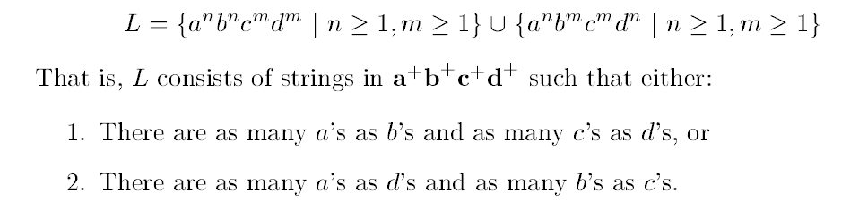
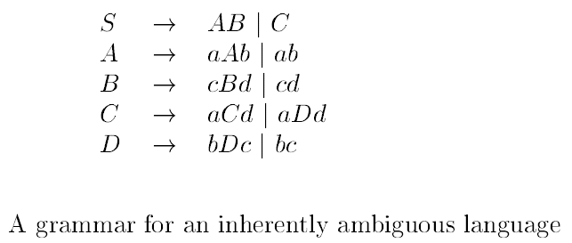
Another Example

Slide 49
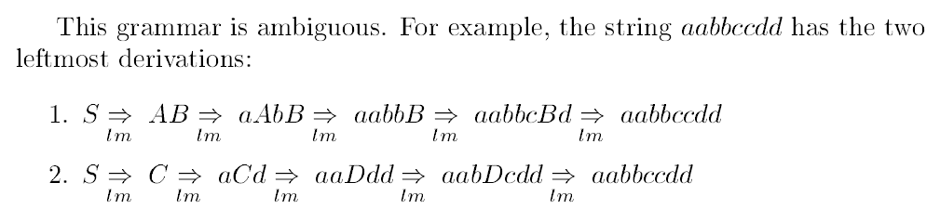

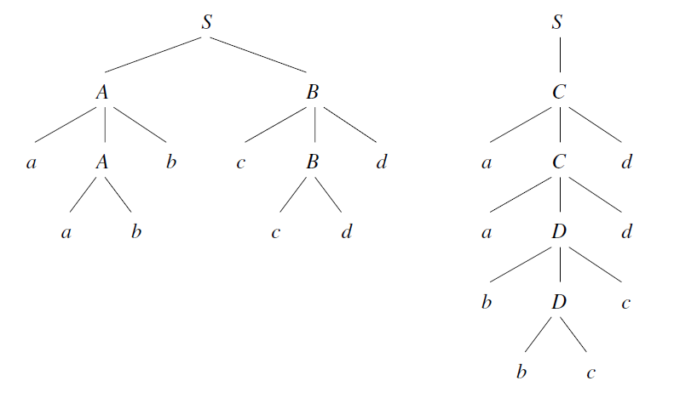
Contd…

Slide 50
Try yourself!!
Solve all the relevant exercises on textbook.

